Slide 1
Analysis of Senator Financial Bias
Tim Coca
DDA6 NSS

Slide 2
Purpose
I set out to develop a resource that can be used to highlight any overlap between senators’ votes and the stocks they own which that legislation might affect. I hope that in using this tool, a voter will be able to extract instances where a representative could have enacted legislation under the influence of financial bias.

Slide 3
Methodology Retrieving Stock Transactions
Transaction Date | Owner | Ticker | Asset Description | Asset Type | Type | Amount | Senator | Disclosure Date
3/9/2022 | Self | TACO | Del Taco Restaurants, Inc. - Common Stock | Stock | Sale (Partial) | $15,001 - $50,000 | William F Hagerty, Iv | 4/13/2022
3/30/2022 | Joint | WST | West Pharmaceutical Services, Inc. Common Stock | Stock | Sale (Full) | $1,001 - $15,000 | Thomas H Tuberville | 4/8/2022
3/30/2022 | Joint | VEEV | Veeva Systems Inc. Class A Common Stock | Stock | Sale (Full) | $1,001 - $15,000 | Thomas H Tuberville | 4/8/2022
3/30/2022 | Joint | VMW | Vmware, Inc. Common stock, Class A | Stock | Sale (Full) | $1,001 - $15,000 | Thomas H Tuberville | 4/8/2022
3/30/2022 | Joint | SNA | Snap-On Incorporated Common Stock | Stock | Sale (Full) | $1,001 - $15,000 | Thomas H Tuberville | 4/8/2022
3/30/2022 | Joint | SIVB | SVB Financial Group - Common Stock | Stock | Sale (Full) | $1,001 - $15,000 | Thomas H Tuberville | 4/8/2022
3/30/2022 | Joint | SPGI | S&amp;P Global Inc. Common Stock | Stock | Sale (Full) | $1,001 - $15,000 | Thomas H Tuberville | 4/8/2022
3/30/2022 | Joint | ROK | Rockwell Automation, Inc. Common Stock | Stock | Sale (Full) | $1,001 - $15,000 | Thomas H Tuberville | 4/8/2022
3/30/2022 | Joint | REGN | Regeneron Pharmaceuticals, Inc. - Common Stock | Stock | Sale (Full) | $1,001 - $15,000 | Thomas H Tuberville | 4/8/2022
3/30/2022 | Joint | NFLX | Netflix, Inc. - Common Stock | Stock | Sale (Full) | $1,001 - $15,000 | Thomas H Tuberville | 4/8/2022
3/30/2022 | Joint | LMST | Limestone Bancorp, Inc. - Common Stock | Stock | Purchase | $1,001 - $15,000 | Thomas H Tuberville | 4/8/2022
3/30/2022 | Joint | KEY | KeyCorp Common Stock | Stock | Purchase | $1,001 - $15,000 | Thomas H Tuberville | 4/8/2022
3/30/2022 | Joint | INTU | Intuit Inc. - Common Stock | Stock | Sale (Full) | $1,001 - $15,000 | Thomas H Tuberville | 4/8/2022
3/30/2022 | Joint | GNRC | Generac Holdlings Inc. Common Stock | Stock | Sale (Full) | $1,001 - $15,000 | Thomas H Tuberville | 4/8/2022
3/30/2022 | Joint | FGBI | First Guaranty Bancshares, Inc. - Common Stock | Stock | Purchase | $1,001 - $15,000 | Thomas H Tuberville | 4/8/2022
3/30/2022 | Joint | FITB | Fifth Third Bancorp - Common Stock | Stock | Purchase | $1,001 - $15,000 | Thomas H Tuberville | 4/8/2022
3/30/2022 | Joint | EXP | Eagle Materials Inc Common Stock | Stock | Sale (Full) | $1,001 - $15,000 | Thomas H Tuberville | 4/8/2022
3/30/2022 | Joint | DEO | Diageo plc Common Stock | Stock | Sale (Full) | $1,001 - $15,000 | Thomas H Tuberville | 4/8/2022
3/30/2022 | Joint | CFG | Citizens Financial Group, Inc. Common Stock | Stock | Purchase | $1,001 - $15,000 | Thomas H Tuberville | 4/8/2022
3/30/2022 | Joint | CE | Celanese Corporation Celanese Corporation Common S | Stock | Sale (Full) | $1,001 - $15,000 | Thomas H Tuberville | 4/8/2022
3/30/2022 | Joint | CP | Canadian Pacific Railway Ltd | Stock | Sale (Full) | $1,001 - $15,000 | Thomas H Tuberville | 4/8/2022
3/30/2022 | Joint | CABO | Cable One, Inc. Common Stock | Stock | Sale (Full) | $1,001 - $15,000 | Thomas H Tuberville | 4/8/2022
3/30/2022 | Joint | BKE | Buckle, Inc. (The) Common Stock | Stock | Sale (Full) | $1,001 - $15,000 | Thomas H Tuberville | 4/8/2022
3/30/2022 | Joint | BIO | Bio-Rad Laboratories, Inc. Class A Common Stock | Stock | Sale (Full) | $1,001 - $15,000 | Thomas H Tuberville | 4/8/2022
3/30/2022 | Joint | BMO | Bank of Montreal | Stock | Purchase | $1,001 - $15,000 | Thomas H Tuberville | 4/8/2022
3/30/2022 | Joint | TMO | Thermo Fisher Scientific Inc Common Stock | Stock | Purchase | $1,001 - $15,000 | Thomas H Tuberville | 4/8/2022
3/30/2022 | Joint | RMD | ResMed Inc. Common Stock | Stock | Purchase | $1,001 - $15,000 | Thomas H Tuberville | 4/8/2022
3/30/2022 | Joint | RF | Regions Financial Corporation Common Stock | Stock | Purchase | $1,001 - $15,000 | Thomas H Tuberville | 4/8/2022
3/30/2022 | Joint | NOC | Northrop Grumman Corporation Common Stock | Stock | Purchase | $1,001 - $15,000 | Thomas H Tuberville | 4/8/2022
3/30/2022 | Joint | NDAQ | Nasdaq, Inc. - Common Stock | Stock | Purchase | $1,001 - $15,000 | Thomas H Tuberville | 4/8/2022
3/30/2022 | Joint | MRK | Merck &amp; Company, Inc. Common Stock (new) | Stock | Purchase | $1,001 - $15,000 | Thomas H Tuberville | 4/8/2022
3/30/2022 | Joint | MASI | Masimo Corporation - Common Stock | Stock | Purchase | $1,001 - $15,000 | Thomas H Tuberville | 4/8/2022
I began by retrieving publicly disclosed stock transactions for members of the Senate (shown to the right)
These were easily downloadable from:
https://senatestockwatcher.com/
Ideas for improvement:
I hope to adapt this dataset to refresh itself in pursuit of always having updated data
If given the time, I’d like to also integrate campaign contributions and lobbyist group donations

Slide 4
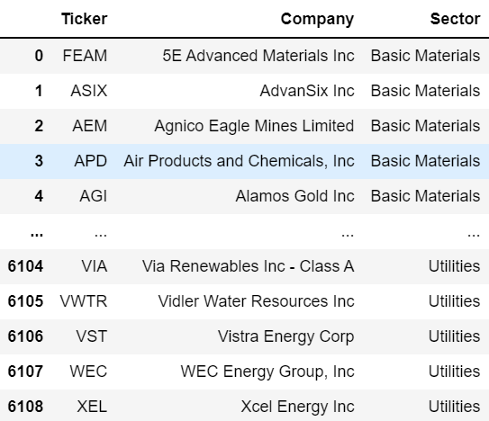
Methodology Categorizing Stocks by Sector
For the categorization, I scraped data from https://www.stockmonitor.com/ (shown to the right)
This proved advantageous since the sector list is standardized across industries, as opposed to having stocks assigned to a sector arbitrarily
Ideas for improvement:
While the index provided by this webscrape was extensive, I can continue to find additional sources for categorizing more stocks; this will lead to more matches when it comes to finding matches for potential bias

Slide 5
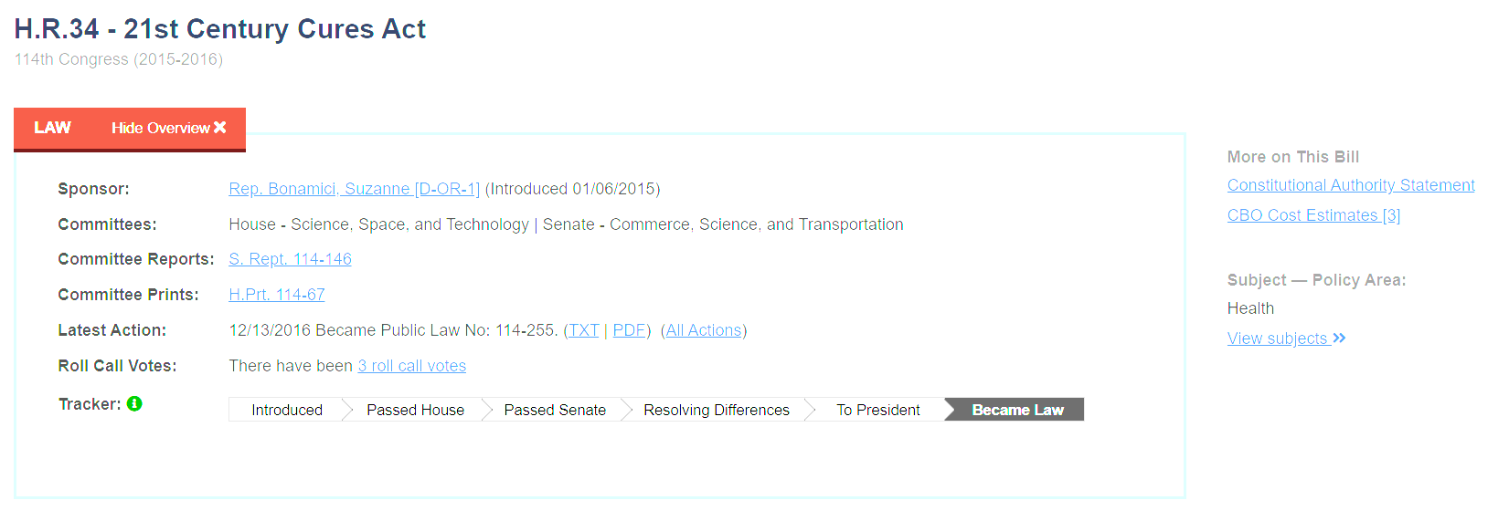
Methodology Categorizing Legislation by Policy Area
To accomplish this, I scraped data from https://www.congress.gov/
Similar to the stock categorization by sector, the way that these pieces of legislature are assigned a policy area was helpful;https://www.congress.gov/ has a team of researchers dedicated to determining the most appropriate subject assignment for each bill, meaning that the assignment can be trusted (shown as example in red circle)
I conducted this categorization in Python using a dictionary. The dictionary had to be indexed by bill number as well as session of Congress, as the bill number resets with each new session of Congress

Slide 6
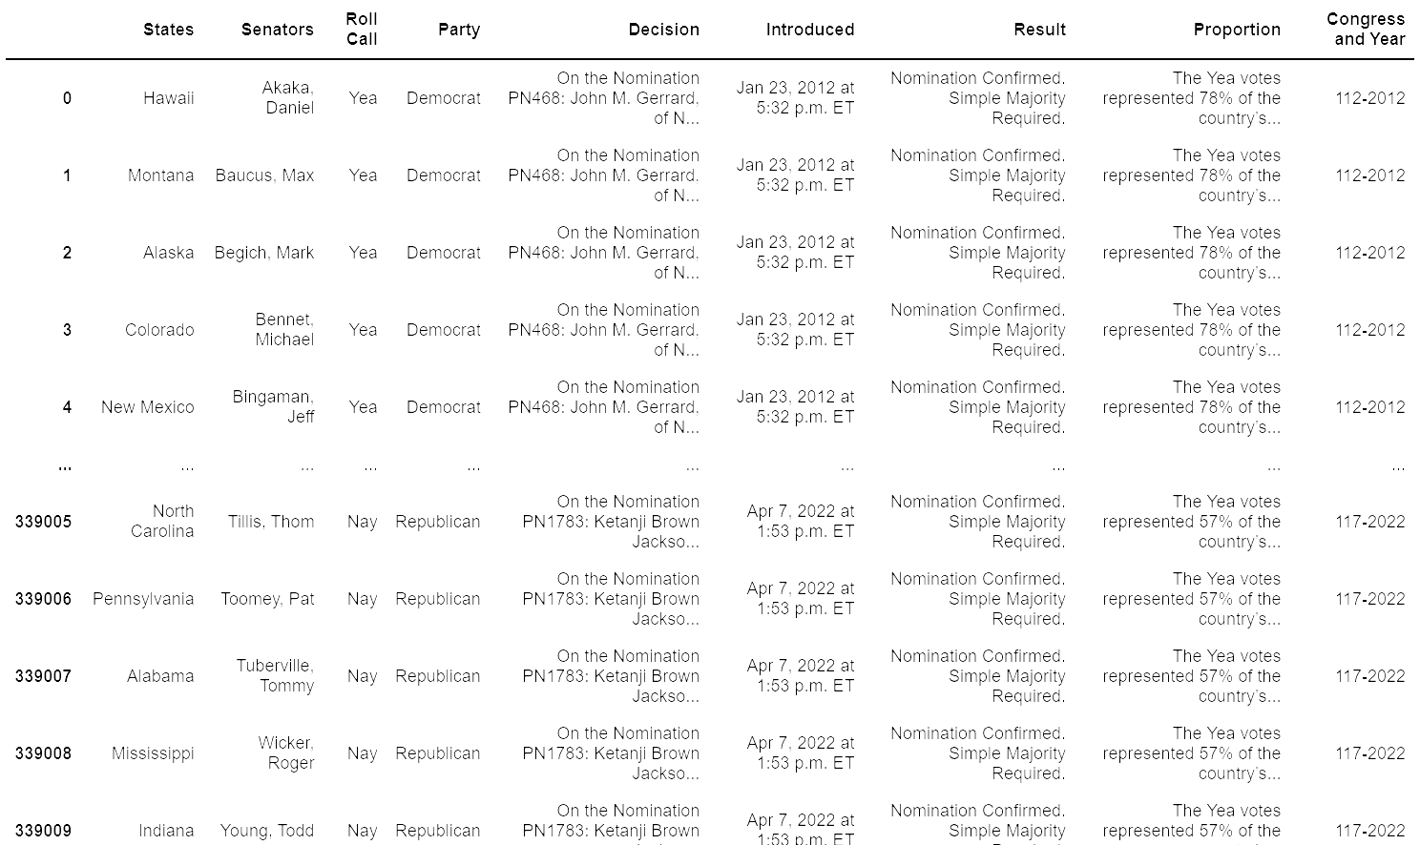
Methodology Acquisition of Roll Call Votes by Senator
With webscraping, I iterated through roll call votes in https://www.govtrack.us to produce a DataFrame (shown to the right)
Contained are all the roll call votes from 2012 until present
This DataFrame will ultimately be joined with stocks owned by the senator in question, so long as the bill has the potential to affect the stock’s growth

Slide 7
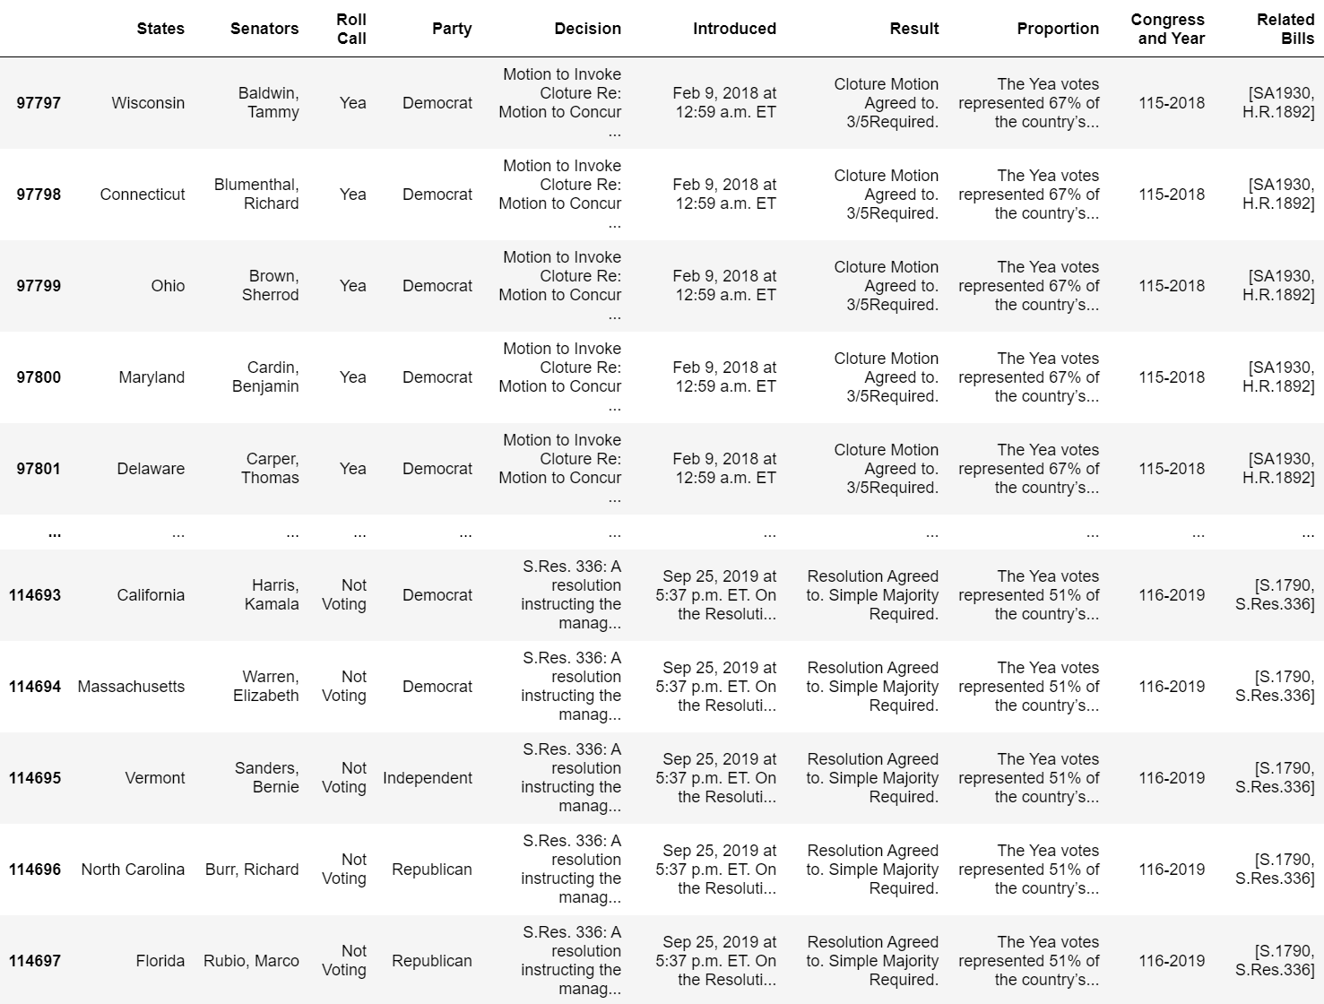
Methodology Finding Bills Related to Decision
Since a decision can involve multiple bills, each item in column ‘Related Bills’ is a list containing those related bills
Ideas for Improvement:
I need to alter the code to index column ‘Related Bills’ by session of Congress as well. This way, the column distinguishes between bill numbers from different sessions

Slide 8
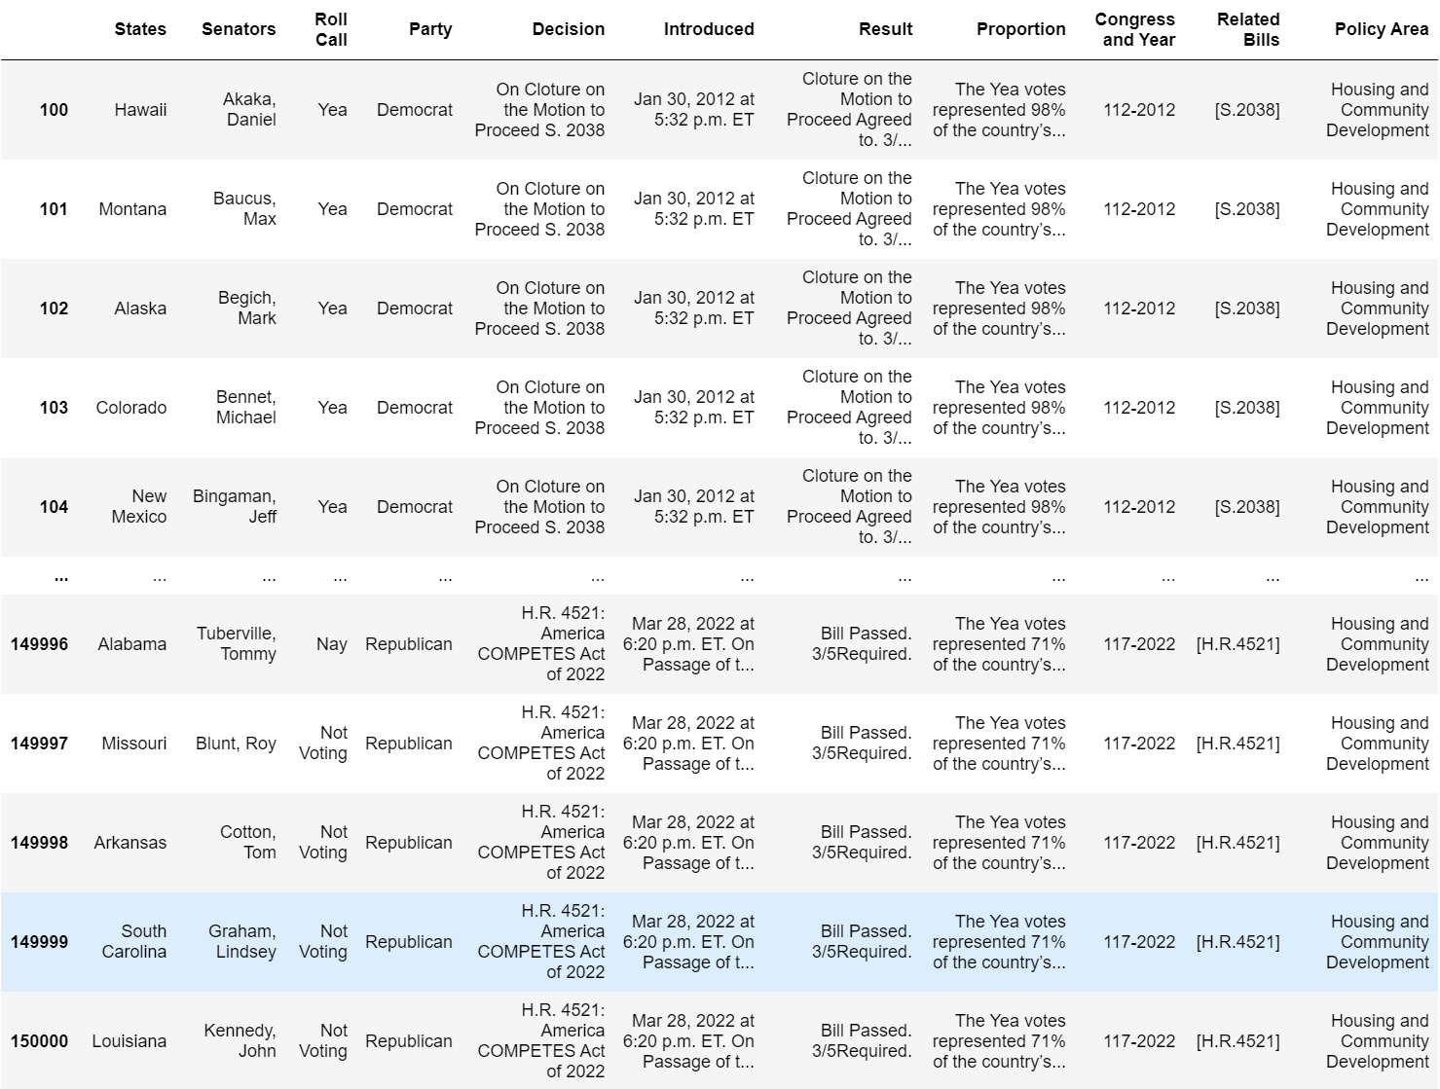
Methodology Deriving Policy Area from Related Bills
Ideas for Improvement:
I will work to see if lists in column ‘Related Bills’ contain bills correlating to different policy areas and if so, what happens to column ‘Policy Area’ as a result

Slide 9
Methodology Assigning Policy Area to Stock Sector
Shown below are what I believe to be the proper assignments thus far after looking into industries to which each policy area/stock relates
Ideas for Improvement:
With more research into the nature of each policy area and stock sector (the industries to which they pertain, I can make more assignments and ultimately get more bias matches
Health
Healthcare
1
Public Lands and Natural Resources
Basic Materials
2
Agriculture and Food
Consumer Defensive
3
Economics and Public Finance
Financial Services
4
Housing and Community Development
Industrials
5
Water Resources Development
Utilities
6

Slide 10

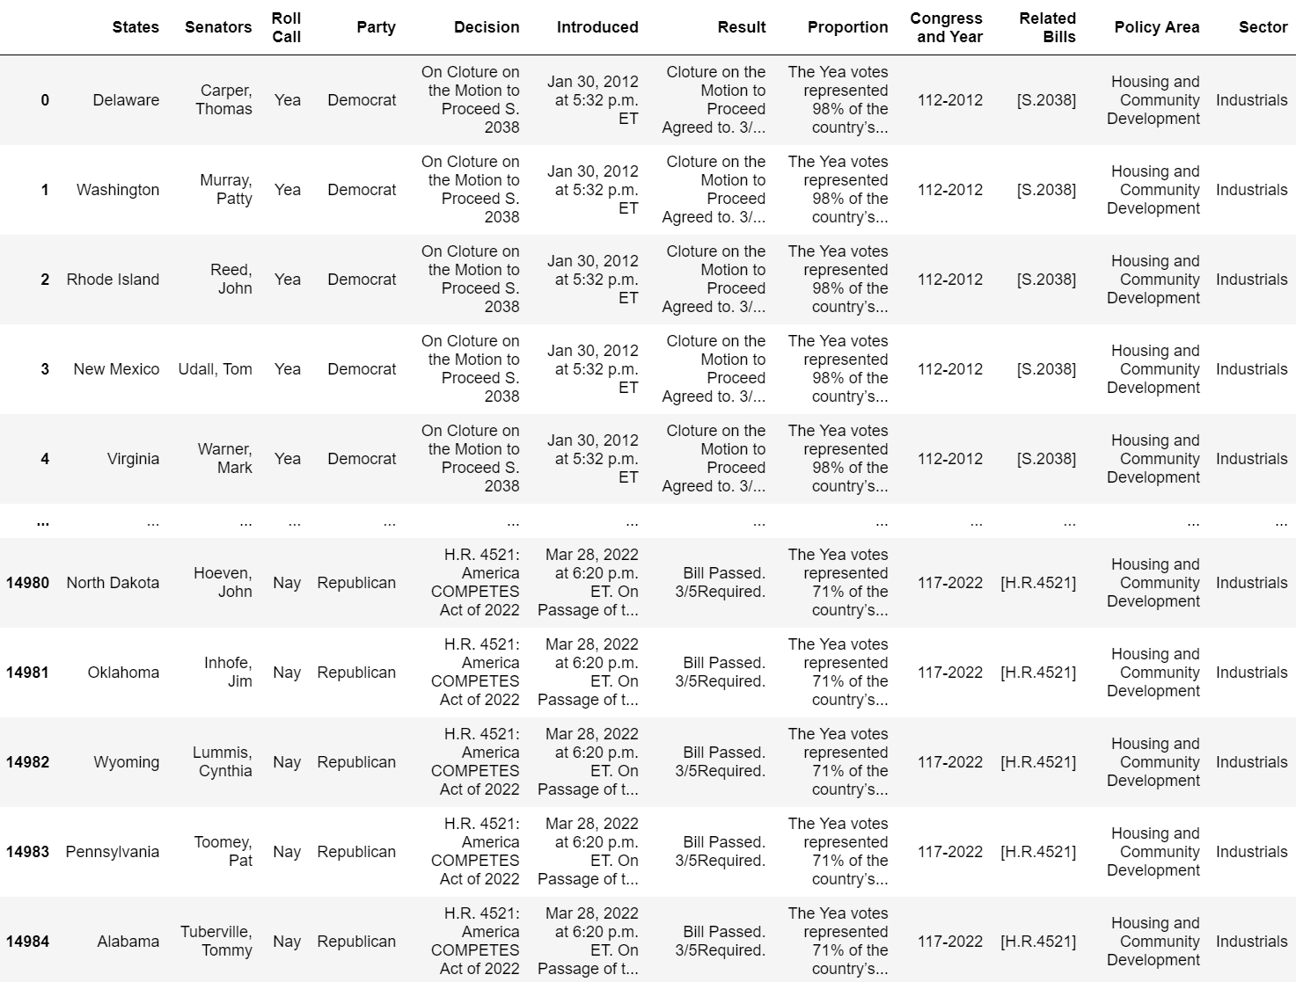

Slide 11
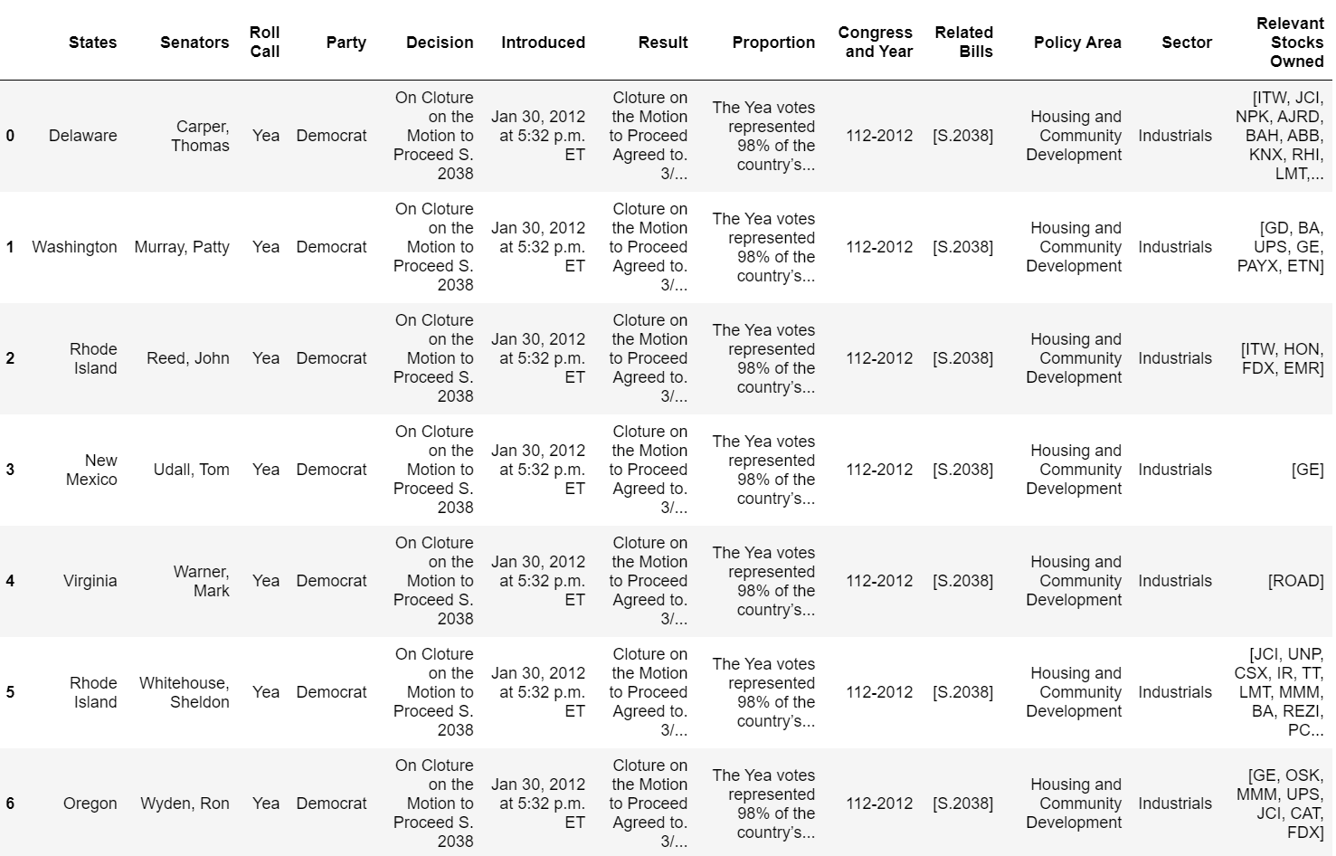
Methodology Final Product (For Now) Stocks Relevant to Roll Call Vote
The column ‘Relevant Stocks Owned’ contains a list of stocks which:
Are owned by the corresponding senator
Correspond to the relevant sector and, by extension, the relevant legislation

Slide 12
Moving Forward…
I hope to create a dashboard that can vizualize the data I’ve created and provide more insights including:
Which party/individual senator has the most occurrences of votes with financial bias?
A measure of how chronologically near (before or after) the roll call vote is to the buying or selling of the stock
A retrieval method that shows a line graph of the value for the stock in question
As mentioned earlier, I would like observe similar correlations between campaign contributions and senators’ ties to the group making the contribution
All the data I pulled for the Senate is available in very much the same format for the House. Given time, I will expand the analysis to members of the House as well
Using NLP, it would be interesting to look at any corporations that are directly named in the text of the legislation and compile similar data connecting a lawmaker’s vote to stock owned by said lawmaker in the company named

Slide 13


Summary
My aim is to continue developing this resource (both in the week to come as well as continued work long after) and have it be used by voters as well as people looking to become more informed about their representatives’ decisions.

Slide 14




Thank you! Any Questions?
cocatimothy@gmail.com
https://github.com/tmcoca
www.linkedin.com/in/timothy-coca

